Slide 1

A Presentation on “Use of alccofine 1206 to achieve high strength of concrete”
Department Of Civil Engineering
Government College Of Engineering, Chandrapur
PRESENTED BY
USMAN SHAIKH
SHUBHAM RAUT MUKESH SAMRIT
KAJAL CHAVHAN MAYURI BURADKAR
H.O.D
Prof.Rajesh.T.Peche
Guided By
Mrs. Kajal Kumari

Slide 2
Contents
Introduction
Objectives
Literature review
Methodology
Conclusion
References

Slide 3
Introduction
In the project, a brief review of literature by using waste material i.e Alccofine 1206 in concrete to improve its strength and stability. Utilization of waste material in concrete has proved that it enhances the properties of mix utilizer for water reduce which improve the properties of flexural, tensile, compressive strength of concrete. Laboratory test have proved that it can be used as admixture in concrete overall construction. Waste material i.e Alccofine 1206 percentage in concrete has to be checked. Compression test is the most commonly used method for examining compressive strength.Alccofine 1206 has been added to OPC which varies from 5% to 15% at interval of 5% by total weight of OPC and partial replacement of OPC 43 grade by Alccofine 1206 which varies from 5% b total weight of OPC. Slump test which was found higher in partial replacement at15% as compared to that of addition of alcohol 1206 for m25 grade of concrete. The test have probability to show positive result and give a scope for further implementation.

Slide 4
Objectives
To perform various taste on course aggregate fine aggregate cement.
To find out physical properties of course aggregate fine aggregate and cement.
To anylyse the results obtained by performing various tests .
To design mixture of concrete m25 great using the values of physical properties found out by previous data.

Slide 5
Literature Review
Saurav, Ashok Kumar Gupta (2014) have investigated on experimental study of strength relationship of concrete cube and concrete cylinder using ultrafine slag alccofine and have shown the comparison between cubical strength and cylindrical strength of normal concrete and with partial replacement of cement with ultra fine slag (alccofine) and varies at 3%, 5%, 7%, 10%, 13%, 15% & 18 %. They found the result is higher compressive cube strength and compressive cylinder strength at 13% replacement of cement with ultra fine slag.
M.S. Pawar, A.C. Saoji (2013) have studied on effect of alccofine on self compacting concrete in which the main variable is proportion of Alccofine keeping cement, fly ash, water, coarse aggregate, fine aggregate and super plasticizer contents constant and they found that the addition of Alcofine in SCC mixes increases the self compatibility characteristic like filling ability passing ability and resistance to segregation and for fresh properties and harden properties of SCCs with 10% alccofine are superior than SCCs with 5% and 15% of alccofine.

Slide 6
Siddharth P. Upadhyay and M. A. Jamnu (2014) have studied the effect on compressive strength of high performance concrete by partial replacement of alccofine and fly ash in OPC-53 grade and also with natural sand to manufactured sand. They have kept the variation of alcofine from 4 to 12 % at interval of 2% and fly-ash remains constant 30% of total OPC and found maximum compressive strength of concrete is achieved by using Alcofine 10% and Fly Ash 30% for 28 days curing. They have also gained the strength between 3 to 7 days which is excellent but between 7 to 28 days strength gain comparatively slow or less. Due to Changes in w/c ratio 0.45 to 0.5 higher compressive strength is also achieved in a minor difference.
Deval Soni , Suhasini Kulkarni and Vilin Parekh (2013) have reported the experimental study on high-performance concrete, with mixing of alcofine and fly ash by means of partial replacement of alccofine1203 and fly ash by weight of cement. They get maximum compressive & flexural strength when cement is replaced by 24% (1.e. 8% alcofine & 16% fly ash).

Slide 7
METHODOLOGY
MATERIALS
For production of concrete, the ingredients cement, Fine aggregate, coarse aggregate, water are used .The ingredients used for experimentation are discussed below.
1.Cement: - The 43 grade of ordinary Portland cement of ACC brand was used for the experiment work. The specific gravity of cement is assumed about 3.12
2. Fine Aggregate: - The sand for the experiment work is obtained Locally available sand (River sand) thus sieved through 4.75mm IS sieve for experiment work
3.Coarse Aggregate: - The aggregate used for the experiment was 20mm Size
4.Water: - As prescribed in IS:456-2000, the potable water is used for mixing concrete

Slide 8
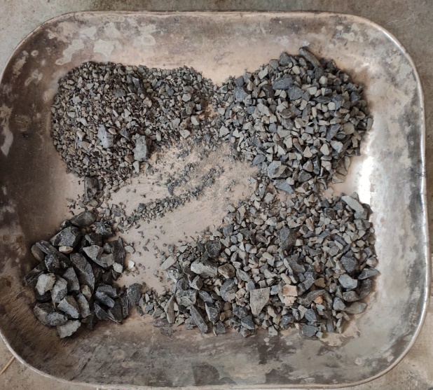
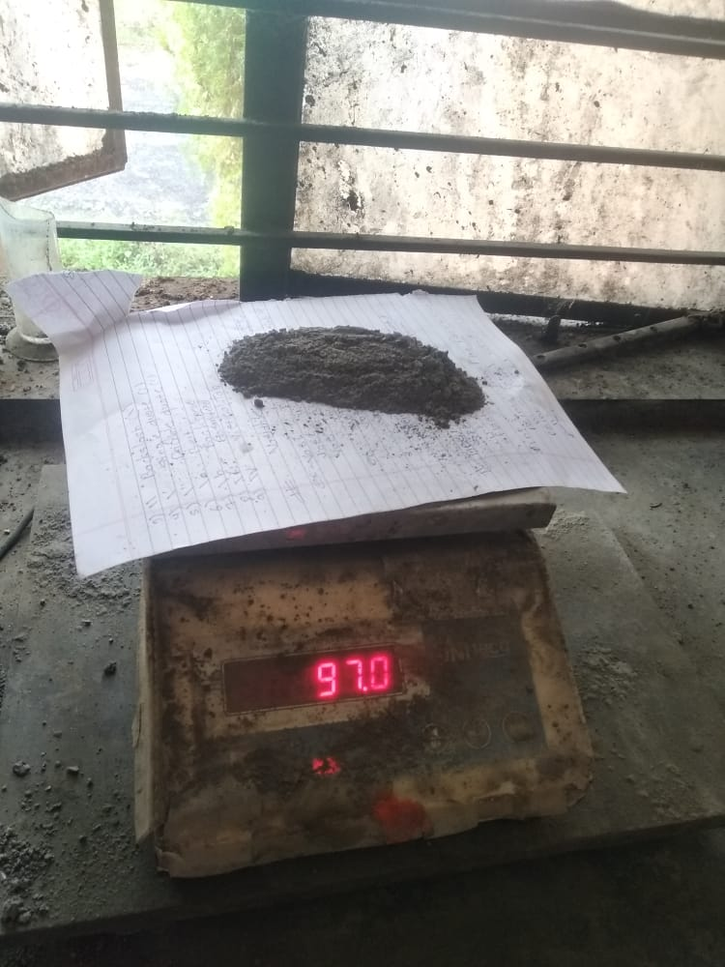
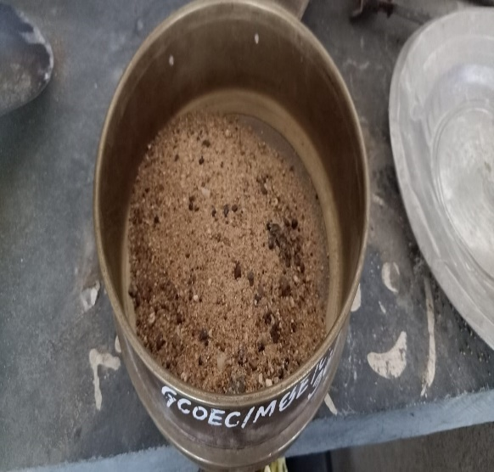
METHODOLOGY
Aggregate
Cement (OPC43)
Fineaggregate

Slide 9
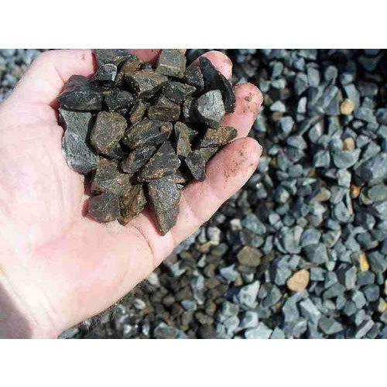
Coarse Aggregate Test & Results
Coarse Aggregate Impact Value Test
Coarse Aggregate Crushing Value Test
Coarse Aggregate Abrasion Value Test
4. Coarse Aggregate Specific Gravity
5. Coarse Aggregate Water Absorption
Sr.No | Test Value | 10 mm | 20mm
1. | Impact Value | 13.96% | 15.86%
2. | Crushing Value | 18.40% | 19.48%
3. | Abrasion Value | 15.56% | 17.12%
4. | Specific Gravity | 2.62 | 2.66
5. | Water Absorption | 0.46 | 0.45

Slide 10
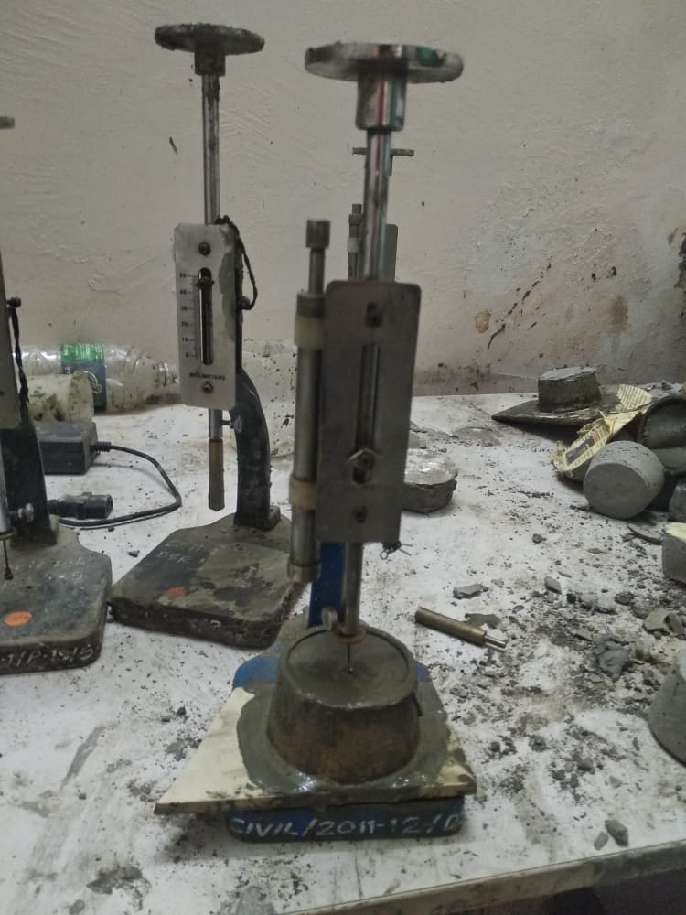
Cement Test & Result
1. Cement fineness test
2. Cement consistency test
3. Cement soundness test
4. Cement initial setting time
5. Cement finial setting time
6. Cement specific gravity test
Sr.No | Test | Result
1. | Fineness | 5%
2. | Constistency | 30%
3. | Soundness | 1.92 mm
4. | Initial setting time | 30 min
5. | Final setting time | 285min
6. | Specific gravity | 3.12

Slide 11
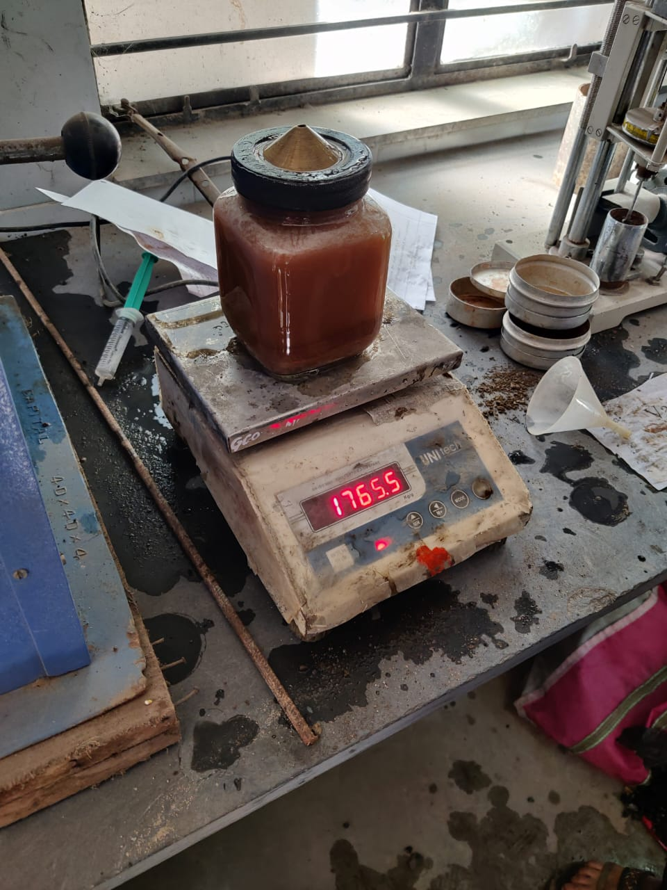
Fine Aggregate Test And Result
1. Fine Aggregate Water Absorption Test
2. Fine Aggregate Fineness Modulus Test
3. Fine Aggregate Specific Gravity Test
Sr.No | Test | Result
1. | Water Absorption | 1.6%
2. | Fineness | 2.67
3. | Specific Gravity | 2.40

Slide 12
Conclusion
We have perform various test each for three time for better result which were founded by taking average of all results founded.
From results , physical properties of course aggregate ,fine aggregate and cement i.e fineness, consistency soundness has been determined.
The results of all test performed on given materials were analyzed.
Using observations made under various test we had use these values to make mix design of concrete.
By using different values , we have done various calculation for mix design such as calculation of water cement ratio, requirements of water, fine aggregates, coarse aggregates.

Slide 13
References
[1] Saurav and Ashok Kumar Gupta “Experimental Study Of Strength Relationship Of Concrete Cube And Concrete Cylinder Using Ultrafine Slag Alccofine” International Journal of Scientific & Engineering Research, ISSN 2229-5518, Volume 5, Issue 5, , pp. 102 -107, May-2014.
[2] M.S. Pawar and A.C. Saoji “Effect of Alccofine on Self Compacting Concrete” The International Journal of Engineering and Science, eISSN: 2319-1813 pISSN: 2319 – 1805, volume 2, issue 6, pp. 5-9, 2013.
[3] Siddharth P. Upadhyay and M. A. Jamnu “Effect on Compressive strength of High Performance Concrete Incorporating Alccofine and Fly Ash” International Journal Of Innovative Research & Development, ISSN 2278 – 0211, volume 3, issue 2,pp.124-128, February 2014.
[4] Deval Soni, Suhasini Kulkarni and Vilin Parekh “Experimental Study on High-Performance Concrete, with Mixing of Alccofine and Flyash’’Paripex - Indian Journal of Research, Issn - 2250-1991, volume 3, issue 4, pp. 84-86, May 2013.

Slide 14
FUTURE WORK HAS TO BE DONE...
The testing of sample Cubes and Cylinder which are cast has to be done.
Using varying percentage of Alccofine 1206 from 5% to 15% at interval of 5% of total weight of OPC43 and partial replacement of OPC (43 grade) by alccofine 1206 which have varies from 5% to 15% at interval of 5% by total weight of OPC.
Casting of cubes and Cylinder using alccofine 1206.
All mixes of Fresh Concrete will be examine for slump test.
Comparision between sample created by using and without using Alccofine 1206 both for strength and stability.

Slide 15

Thanking you

